Slide 1
Chapter 2 Operating System Overview
Operating Systems: Internals and Design Principles
Seventh Edition
By William Stallings
Notes:
“Operating Systems: Internal and Design Principles”, 7/e, by William Stallings, Chapter 2 “Operating System Overview”.

Slide 2
Operating Systems: Internals and Design Principles
Operating systems are those programs that interface the machine with
the applications programs. The main function of these systems is to
dynamically allocate the shared system resources to the executing
programs. As such, research in this area is clearly concerned with
the management and scheduling of memory, processes, and other
devices. But the interface with adjacent levels continues to shift with
time. Functions that were originally part of the operating system have
migrated to the hardware. On the other side, programmed functions
extraneous to the problems being solved by the application programs
are included in the operating system.
—WHAT CAN BE AUTOMATED?: THE COMPUTER SCIENCE AND
ENGINEERING RESEARCH STUDY,
MIT Press, 1980
Notes:
We begin our study of operating systems (OSs) with a brief history. This history is
itself interesting and also serves the purpose of providing an overview of OS principles.
The first section examines the objectives and functions of operating systems.
Then we look at how operating systems have evolved from primitive batch systems
to sophisticated multitasking, multiuser systems. The remainder of the chapter looks
at the history and general characteristics of the two operating systems that serve as
examples throughout this book. All of the material in this chapter is covered in
greater depth later in the book.

Slide 3
Operating System
Exploits the hardware resources of one or more processors to provide a set of services to system users
Manages secondary memory and I/O devices
An OS is a program that controls the execution of application programs and acts as an interface between applications and the computer hardware.
Notes:
An OS is a program that controls the execution of application programs and acts as
an interface between applications and the computer hardware. It can be thought of
as having three objectives:
• Convenience: An OS makes a computer more convenient to use.
• Efficiency: An OS allows the computer system resources to be used in an efficient
manner.
• Ability to evolve: An OS should be constructed in such a way as to permit the
effective development, testing, and introduction of new system functions without
interfering with service.

Slide 4
Operating System
Main objectives of an OS:
Convenience: An OS makes a computer more convenient to use.
Efficiency: An OS allows the computer system resources to be used in an efficient manner.
Ability to evolve: An OS should be constructed in such a way as to permit the effective development, testing, and introduction of new system functions without interfering with service efficiency

Slide 5
Operating System
Main Functions of an OS:
Manage the computer's resources, such as the central processing unit, memory, disk drives, and printers,
Establish user interface
Execute and provide services for applications software.

Slide 6
The OS as a User/Computer Interface
OS provides services to users

Slide 7

Operating System Services
Program development
Program execution
Access I/O devices
Controlled access to files
System access
Error detection and response
Accounting
Notes:
Briefly, the OS typically provides services in the following areas:
• Program development: The OS provides a variety of facilities and services,
such as editors and debuggers, to assist the programmer in creating programs.
Typically, these services are in the form of utility programs that, while not
strictly part of the core of the OS, are supplied with the OS and are referred to
as application program development tools.
• Program execution: A number of steps need to be performed to execute a
program. Instructions and data must be loaded into main memory, I/O devices
and files must be initialized, and other resources must be prepared. The OS
handles these scheduling duties for the user.
• Access to I/O devices: Each I/O device requires its own peculiar set of instructions
or control signals for operation. The OS provides a uniform interface
that hides these details so that programmers can access such devices using simple
reads and writes.
• Controlled access to files: For file access, the OS must reflect a detailed understanding
of not only the nature of the I/O device (disk drive, tape drive) but
also the structure of the data contained in the files on the storage medium.
In the case of a system with multiple users, the OS may provide protection
mechanisms to control access to the files.
• System access: For shared or public systems, the OS controls access to the
system as a whole and to specific system resources. The access function must
provide protection of resources and data from unauthorized users and must
resolve conflicts for resource contention.
• Error detection and response: A variety of errors can occur while a computer
system is running. These include internal and external hardware errors, such
as a memory error, or a device failure or malfunction; and various software
errors, such as division by zero, attempt to access forbidden memory location,
and inability of the OS to grant the request of an application. In each case,
the OS must provide a response that clears the error condition with the least
impact on running applications. The response may range from ending the program
that caused the error, to retrying the operation, to simply reporting the
error to the application.
• Accounting: A good OS will collect usage statistics for various resources and
monitor performance parameters such as response time. On any system, this
information is useful in anticipating the need for future enhancements and in
tuning the system to improve performance. On a multiuser system, the information
can be used for billing purposes.

Slide 8
The Operating System as a
Resource Manager
A computer is a set of resources for moving, storing, & processing data
The OS is responsible for managing these resources
The OS exercises its control through software
Notes:
A computer is a set of resources for the movement, storage, and processing of data
and for the control of these functions. The OS is responsible for managing these
resources.

Slide 9
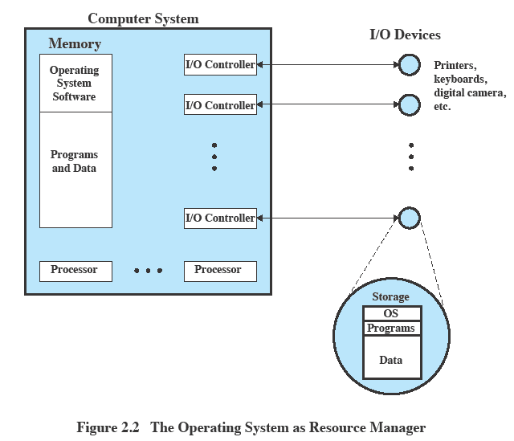
Operating System as Resource Manager
Notes:
Figure 2.2 suggests the main resources that are managed by the OS. A portion
of the OS is in main memory. This includes the kernel , or nucleus , which contains
the most frequently used functions in the OS and, at a given time, other portions
of the OS currently in use. The remainder of main memory contains user programs
and data. The memory management hardware in the processor and the OS jointly
control the allocation of main memory, as we shall see. The OS decides when an I/O
device can be used by a program in execution and controls access to and use of files.
The processor itself is a resource, and the OS must determine how much processor
time is to be devoted to the execution of a particular user program. In the case of a
multiple-processor system, this decision must span all of the processors.

Slide 10
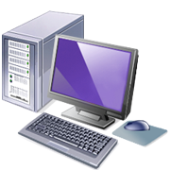
Operating System as Software
Functions in the same way as ordinary computer software
Program, or suite of programs, executed by the processor
Frequently relinquishes control and must depend on the processor to allow it to regain control
Notes:
The OS, as a control mechanism is unusual in two respects:
• The OS functions in the same way as ordinary computer software; that is, it is
a program or suite of programs executed by the processor.
• The OS frequently relinquishes control and must depend on the processor to
allow it to regain control.
Like other computer programs, the OS provides instructions for the processor.
The key difference is in the intent of the program. The OS directs the processor
in the use of the other system resources and in the timing of its execution of other
programs. But in order for the processor to do any of these things, it must cease
executing the OS program and execute other programs. Thus, the OS relinquishes
control for the processor to do some “useful” work and then resumes control long
enough to prepare the processor to do the next piece of work. The mechanisms
involved in all this should become clear as the chapter proceeds.

Slide 11
Evolution of Operating Systems
A major OS will evolve over time for a number of reasons:
Hardware upgrades
New types of hardware
New services
Fixes
Notes:
A major OS will evolve over time for a number of reasons:
• Hardware upgrades plus new types of hardware: For example, early versions
of UNIX and the Macintosh OS did not employ a paging mechanism because
they were run on processors without paging hardware. 1 Subsequent versions
of these operating systems were modified to exploit paging capabilities. Also,
the use of graphics terminals and page-mode terminals instead of line-at-a time
scroll mode terminals affects OS design. For example, a graphics terminal
typically allows the user to view several applications at the same time through
“windows” on the screen. This requires more sophisticated support in the OS.
• New services: In response to user demand or in response to the needs of system
managers, the OS expands to offer new services. For example, if it is found
to be difficult to maintain good performance for users with existing tools, new
measurement and control tools may be added to the OS.
• Fixes: Any OS has faults. These are discovered over the course of time and
fixes are made. Of course, the fix may introduce new faults.
The need to change an OS regularly places certain requirements on its design.
An obvious statement is that the system should be modular in construction, with
clearly defined interfaces between the modules, and that it should be well documented.
For large programs, such as the typical contemporary OS, what might be
referred to as straightforward modularization is inadequate [DENN80a]. That is,
much more must be done than simply partitioning a program into modules. We
return to this topic later in this chapter.

Slide 12
Evolution of Operating Systems
Stages include:
Serial Processing
Simple Batch Systems
Multiprogrammed Batch Systems
Time Sharing Systems
Notes:
In attempting to understand the key requirements for an OS and the significance of the major features of a contemporary OS, it is useful to consider how operating systems have evolved over the years.

Slide 13
Serial Processing
Earliest Computers:
Problems:
Scheduling:
most installations used a hardcopy sign-up sheet to reserve computer time
time allocations could run short or long, resulting in wasted computer time
Setup time
a considerable amount of time was spent just on setting up the program to run
No operating system
programmers interacted directly with the computer hardware
Computers ran from a console with display lights, toggle switches, some form of input device, and a printer
Users have access to the computer in “series”
Notes:
With the earliest computers, from the late 1940s to the mid-1950s, the programmer
interacted directly with the computer hardware; there was no OS. These computers
were run from a console consisting of display lights, toggle switches, some form of
input device, and a printer. Programs in machine code were loaded via the input
device (e.g., a card reader). If an error halted the program, the error condition was
indicated by the lights. If the program proceeded to a normal completion, the output
appeared on the printer.
These early systems presented two main problems:
• Scheduling : Most installations used a hardcopy sign-up sheet to reserve computer
time. Typically, a user could sign up for a block of time in multiples of a
half hour or so. A user might sign up for an hour and finish in 45 minutes; this
would result in wasted computer processing time. On the other hand, the user
might run into problems, not finish in the allotted time, and be forced to stop
before resolving the problem.
• Setup time: A single program, called a job , could involve loading the compiler
plus the high-level language program (source program) into memory,
saving the compiled program (object program) and then loading and linking
together the object program and common functions. Each of these steps could
involve mounting or dismounting tapes or setting up card decks. If an error
occurred, the hapless user typically had to go back to the beginning of the
setup sequence. Thus, a considerable amount of time was spent just in setting
up the program to run.
This mode of operation could be termed serial processing , reflecting the fact
that users have access to the computer in series. Over time, various system software
tools were developed to attempt to make serial processing more efficient. These
include libraries of common functions, linkers, loaders, debuggers, and I/O driver
routines that were available as common software for all users.

Slide 14
Simple Batch Systems
Early computers were very expensive
important to maximize processor utilization
Monitor software
user no longer has direct access to processor
user submits the job on cards or tape to a computer operator, who batches the jobs together sequentially and places the entire batch on an input device, for use by the monitor.
program branches back to the monitor when finished
Notes:
Early computers were very expensive, and therefore it was important to maximize
processor utilization. The wasted time due to scheduling and setup time was
unacceptable.
To improve utilization, the concept of a batch OS was developed. It appears
that the first batch OS (and the first OS of any kind) was developed in the mid-1950s
by General Motors for use on an IBM 701 [WEIZ81]. The concept was subsequently
refined and implemented on the IBM 704 by a number of IBM customers. By the
early 1960s, a number of vendors had developed batch operating systems for their
computer systems. IBSYS, the IBM OS for the 7090/7094 computers, is particularly
notable because of its widespread influence on other systems.
The central idea behind the simple batch-processing scheme is the use of a
piece of software known as the monitor . With this type of OS, the user no longer has
direct access to the processor. Instead, the user submits the job on cards or tape to a
computer operator, who batches the jobs together sequentially and places the entire
batch on an input device, for use by the monitor. Each program is constructed to
branch back to the monitor when it completes processing, at which point the monitor
automatically begins loading the next program.

Slide 15
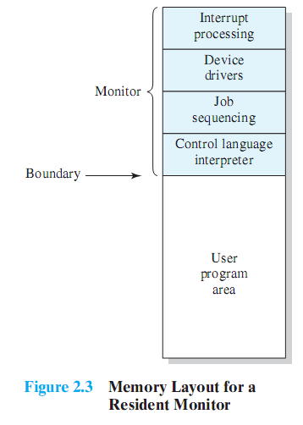
Monitor Point of View
Monitor controls the sequence of events
Resident Monitor is software always in memory
Monitor reads in job and gives control
Job returns control to monitor
Notes:
Monitor point of view: The monitor controls the sequence of events. For this
to be so, much of the monitor must always be in main memory and available
for execution ( Figure 2.3 ). That portion is referred to as the resident monitor .
The rest of the monitor consists of utilities and common functions that are
loaded as subroutines to the user program at the beginning of any job that
requires them. The monitor reads in jobs one at a time from the input device
(typically a card reader or magnetic tape drive). As it is read in, the current job
is placed in the user program area, and control is passed to this job. When the
job is completed, it returns control to the monitor, which immediately reads
in the next job. The results of each job are sent to an output device, such as a
printer, for delivery to the user.

Slide 16
Processor Point of View
Processor executes instruction from the memory containing the monitor
Executes the instructions in the user program until it encounters an ending or error condition
“control is passed to a job” means processor is fetching and executing instructions in a user program
“control is returned to the monitor” means that the processor is fetching and executing instructions from the monitor program
Notes:
Processor point of view: At a certain point, the processor is executing instructions
from the portion of main memory containing the monitor. These
instructions cause the next job to be read into another portion of main
memory. Once a job has been read in, the processor will encounter a branch
instruction in the monitor that instructs the processor to continue execution
at the start of the user program. The processor will then execute the instructions
in the user program until it encounters an ending or error condition.
Either event causes the processor to fetch its next instruction from the monitor
program. Thus the phrase “control is passed to a job” simply means that
the processor is now fetching and executing instructions in a user program,
and “control is returned to the monitor” means that the processor is now
fetching and executing instructions from the monitor program.

Slide 17
Modes of Operation
User Mode
user program executes in user mode
certain areas of memory are protected from user access
certain instructions may not be executed
Kernel Mode
monitor executes in kernel mode
privileged instructions may be executed
protected areas of memory may be accessed
Notes:
Considerations of memory protection and privileged instructions lead to the
concept of modes of operation. A user program executes in a user mode , in which
certain areas of memory are protected from the user’s use and in which certain
instructions may not be executed. The monitor executes in a system mode, or what
has come to be called kernel mode , in which privileged instructions may be executed
and in which protected areas of memory may be accessed.
Of course, an OS can be built without these features. But computer vendors
quickly learned that the results were chaos, and so even relatively primitive batch
operating systems were provided with these hardware features.

Slide 18
Simple Batch System Overhead
Processor time alternates between execution of user programs and execution of the monitor
Sacrifices:
some main memory is now given over to the monitor
some processor time is consumed by the monitor
Notes:
With a batch OS, processor time alternates between execution of user programs
and execution of the monitor. There have been two sacrifices: Some main
memory is now given over to the monitor and some processor time is consumed by
the monitor. Both of these are forms of overhead. Despite this overhead, the simple
batch system improves utilization of the computer.

Slide 19
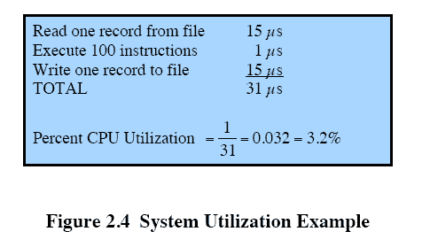
Multiprogrammed Batch Systems
Processor is often idle
even with automatic job sequencing
I/O devices are slow compared to processor
Notes:
Even with the automatic job sequencing provided by a simple batch OS, the processor
is often idle. The problem is that I/O devices are slow compared to the processor.
Figure 2.4 details a representative calculation. The calculation concerns a program
that processes a file of records and performs, on average, 100 machine instructions
per record. In this example, the computer spends over 96% of its time waiting for
I/O devices to finish transferring data to and from the file.

Slide 20

Uniprogramming
The processor spends a certain amount of time executing, until it reaches an I/O instruction; it must then wait until that I/O instruction concludes before proceeding
Notes:
Figure 2.5a illustrates this situation, where we have a single program, referred to as uniprogramming.
The processor spends a certain amount of time executing, until it reaches an I/O instruction.
It must then wait until that I/O instruction concludes before proceeding.

Slide 21
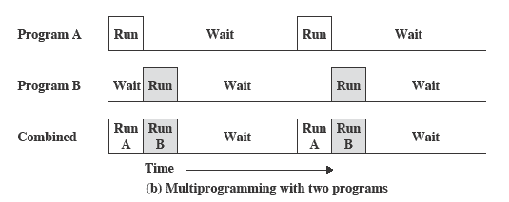
Multiprogramming
There must be enough memory to hold the OS (resident monitor) and one user program
When one job needs to wait for I/O, the processor can switch to the other job, which is likely not waiting for I/O
Notes:
This inefficiency is not necessary. We know that there must be enough
memory to hold the OS (resident monitor) and one user program. Suppose that
there is room for the OS and two user programs. When one job needs to wait for
I/O, the processor can switch to the other job, which is likely not waiting for I/O
( Figure 2.5b ).

Slide 22
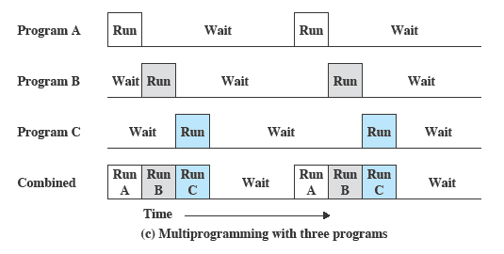
Multiprogramming
Multiprogramming
also known as multitasking
memory is expanded to hold three, four, or more programs and switch among all of them
Notes:
Furthermore, we might expand memory to hold three, four, or more
programs and switch among all of them ( Figure 2.5c ). The approach is known as
multiprogramming , or multitasking . It is the central theme of modern operating
systems.

Slide 23
Time-Sharing Systems
Can be used to handle multiple interactive jobs
Processor time is shared among multiple users
Multiple users simultaneously access the system through terminals, with the OS interleaving the execution of each user program in a short burst or quantum of computation
Notes:
Just as multiprogramming allows the processor to handle multiple batch jobs
at a time, multiprogramming can also be used to handle multiple interactive jobs. In
this latter case, the technique is referred to as time sharing , because processor time is
shared among multiple users. In a time-sharing system, multiple users simultaneously
access the system through terminals, with the OS interleaving the execution of each
user program in a short burst or quantum of computation. Thus, if there are n users
actively requesting service at one time, each user will only see on the average 1/ n
of the effective computer capacity, not counting OS overhead. However, given the
relatively slow human reaction time, the response time on a properly designed system
should be similar to that on a dedicated computer.

Slide 24
Major Advances
Operating Systems are among the most complex pieces of software ever developed
Major advances in development include:
Memory management
Information protection and security
Scheduling and resource management
System structure
Processes
Notes:
Operating systems are among the most complex pieces of software ever developed.
This reflects the challenge of trying to meet the difficult and in some cases
competing objectives of convenience, efficiency, and ability to evolve. [DENN80a]
proposes that there have been four major theoretical advances in the development
of operating systems:
• Processes
• Memory management
• Information protection and security
• Scheduling and resource management
Each advance is characterized by principles, or abstractions, developed to
meet difficult practical problems. Taken together, these five areas span many of
the key design and implementation issues of modern operating systems. The brief
review of these five areas in this section serves as an overview of much of the rest
of the text.

Slide 25
Process
Fundamental to the structure of operating systems
A process can be defined as:
a program in execution
an instance of a running program
the entity that can be assigned to, and executed on, a processor
a unit of activity characterized by a single sequential thread of execution, a current state, and an associated set of system resources
Notes:
Central to the design of operating systems is the concept of process. This term was
first used by the designers of Multics in the 1960s [DALE68]. It is a somewhat
more general term than job. Many definitions have been given for the term process ,
including
• A program in execution
• An instance of a program running on a computer
• The entity that can be assigned to and executed on a processor
• A unit of activity characterized by a single sequential thread of execution, a
current state, and an associated set of system resources

Slide 26
Components of a Process
A process contains three components:
an executable program
the associated data needed by the program (variables, work space, buffers, etc.)
the execution context (or “process state”) of the program
The execution context is essential:
it is the internal data by which the OS is able to supervise and control the process
includes the contents of the various process registers
includes information such as the priority of the process and whether the process is waiting for the completion of a particular I/O event
Notes:
We can think of a process as consisting of three components:
• An executable program
• The associated data needed by the program (variables, work space, buffers, etc.)
• The execution context of the program
This last element is essential.
The execution context, or process state, is the internal data by which the OS is able to supervise and control the process.
This internal information is separated from the process, because the OS has information not permitted to the process.
The context includes all of the information that the OS needs to manage the process and that the processor needs to execute the process properly including:
contents of the various processor registers, such as the program counter and data registers
And information of use to the OS, such as the priority of the process and whether the process is waiting for the completion of a particular I/O event.

Slide 27
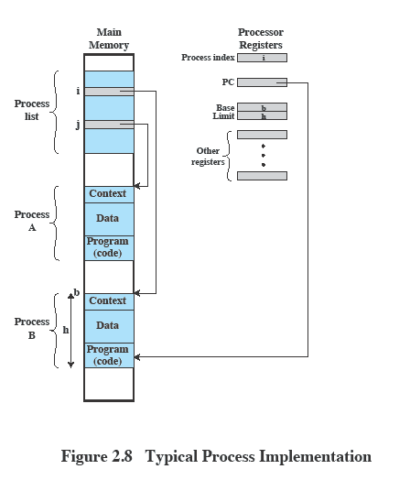
Process Management
The entire state of the process at any instant is contained in its context
New features can be designed and incorporated into the OS by expanding the context to include any new information needed to support the feature
Notes:
Figure 2.8 indicates a way in which processes may be managed. Two processes,
A and B, exist in portions of main memory. That is, a block of memory is
allocated to each process that contains the program, data, and context information.
Each process is recorded in a process list built and maintained by the OS. The
process list contains one entry for each process, which includes a pointer to the
location of the block of memory that contains the process. The entry may also
include part or all of the execution context of the process. The remainder of the
execution context is stored elsewhere, perhaps with the process itself (as indicated
in Figure 2.8 ) or frequently in a separate region of memory. The process index
register contains the index into the process list of the process currently controlling
the processor. The program counter points to the next instruction in that process
to be executed. The base and limit registers define the region in memory occupied
by the process: The base register is the starting address of the region of memory
and the limit is the size of the region (in bytes or words). The program counter and
all data references are interpreted relative to the base register and must not exceed
the value in the limit register. This prevents interprocess interference.
In Figure 2.8 , the process index register indicates that process B is executing.
Process A was previously executing but has been temporarily interrupted. The
contents of all the registers at the moment of A’s interruption were recorded in its
execution context. Later, the OS can perform a process switch and resume execution
of process A. The process switch consists of storing the context of B and restoring
the context of A. When the program counter is loaded with a value pointing into A’s
program area, process A will automatically resume execution.

Slide 28
Memory Management
The OS has five principal storage management responsibilities:
process isolation
long-term storage
protection and access control
support of modular programming
automatic allocation and management
Notes:
The needs of users can be met best by a computing environment that supports
modular programming and the flexible use of data. System managers need efficient
and orderly control of storage allocation. The OS, to satisfy these requirements, has
five principal storage management responsibilities:
• Process isolation: The OS must prevent independent processes from interfering
with each other’s memory, both data and instructions.
• Automatic allocation and management: Programs should be dynamically
allocated across the memory hierarchy as required. Allocation should be
transparent to the programmer. Thus, the programmer is relieved of concerns
relating to memory limitations, and the OS can achieve efficiency by assigning
memory to jobs only as needed.
• Support of modular programming: Programmers should be able to define program
modules, and to create, destroy, and alter the size of modules dynamically.
• Protection and access control: Sharing of memory, at any level of the memory
hierarchy, creates the potential for one program to address the memory space
of another. This is desirable when sharing is needed by particular applications.
At other times, it threatens the integrity of programs and even of the OS itself.
The OS must allow portions of memory to be accessible in various ways by
various users.
• Long-term storage: Many application programs require means for storing
information for extended periods of time, after the computer has been
powered down.

Slide 29
Information Protection and Security
The nature of the threat that concerns an organization will vary greatly depending on the circumstances
The problem involves controlling access to computer systems and the information stored in them
Main issues
availability
confidentiality
data integrity
authenticity
Notes:
The growth in the use of time-sharing systems and, more recently, computer networks
has brought with it a growth in concern for the protection of information.
The nature of the threat that concerns an organization will vary greatly depending
on the circumstances. However, there are some general-purpose tools that can be
built into computers and operating systems that support a variety of protection and
security mechanisms. In general, we are concerned with the problem of controlling
access to computer systems and the information stored in them.
Much of the work in security and protection as it relates to operating systems
can be roughly grouped into four categories:
• Availability: Concerned with protecting the system against interruption.
• Confidentiality: Assures that users cannot read data for which access is
unauthorized.
• Data integrity: Protection of data from unauthorized modification.
• Authenticity: Concerned with the proper verification of the identity of users
and the validity of messages or data.

Slide 30
Scheduling and Resource Management
Key responsibility of an OS is managing resources
Resource allocation policies must consider:
fairness
differential responsiveness
efficiency
Notes:
A key responsibility of the OS is to manage the various resources available to it (main memory space, I/O devices, processors) and to schedule their use by the various active processes.
Any resource allocation and scheduling policy must consider three factors:
Fairness:
Typically, we would like all processes that are competing for the use of a particular resource to be given approximately equal and fair access to that resource.
This is especially so for jobs of the same class, that is, jobs of similar demands.
Differential responsiveness:
On the other hand, the OS may need to discriminate among different classes of jobs with different service requirements.
The OS should attempt to make allocation and scheduling decisions to meet the total set of requirements.
The OS should also make these decisions dynamically.
e.g. if a process is waiting for the use of an I/O device, the OS may wish to schedule that process for execution as soon as possible to free up the device for later demands from other processes.
Efficiency:
The OS should attempt to
maximize throughput,
minimize response time, and
accommodate as many users as possible.
These criteria conflict;
Finding the right balance for a particular situation is an ongoing problem for operating system research.

Slide 31
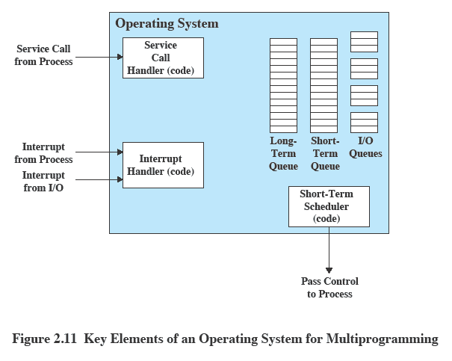
Key Elements of an Operating System
Notes:
Figure 2.11 suggests the major elements of the OS involved in the scheduling
of processes and the allocation of resources in a multiprogramming environment.
The OS maintains a number of queues, each of which is simply a list of processes
waiting for some resource. The short-term queue consists of processes that are in
main memory (or at least an essential minimum portion of each is in main memory)
and are ready to run as soon as the processor is made available. Any one of these
processes could use the processor next. It is up to the short-term scheduler, or
dispatcher, to pick one. A common strategy is to give each process in the queue
some time in turn; this is referred to as a round-robin technique. In effect, the
round-robin technique employs a circular queue. Another strategy is to assign
priority levels to the various processes, with the scheduler selecting processes in
priority order.
The long-term queue is a list of new jobs waiting to use the processor. The
OS adds jobs to the system by transferring a process from the long-term queue to
the short-term queue. At that time, a portion of main memory must be allocated
to the incoming process. Thus, the OS must be sure that it does not overcommit
memory or processing time by admitting too many processes to the system. There
is an I/O queue for each I/O device. More than one process may request the use of
the same I/O device. All processes waiting to use each device are lined up in that
device’s queue. Again, the OS must determine which process to assign to an available
I/O device.
The OS receives control of the processor at the interrupt handler if an interrupt
occurs. A process may specifically invoke some OS service, such as an I/O
device handler by means of a service call. In this case, a service call handler is the
entry point into the OS. In any case, once the interrupt or service call is handled, the
short-term scheduler is invoked to pick a process for execution.
The foregoing is a functional description; details and modular design of this
portion of the OS will differ in various systems. Much of the research and development
effort in operating systems has been directed at picking algorithms and data
structures for this function that provide fairness, differential responsiveness, and
efficiency.

Slide 32
Symmetric Multiprocessing (SMP)
Term that refers to a computer hardware architecture and also to the OS behavior that exploits that architecture
Several processes can run in parallel
Multiple processors are transparent to the user
these processors share same main memory and I/O facilities
all processors can perform the same functions
The OS takes care of scheduling of threads or processes on individual processors and of synchronization among processors
Notes:
Symmetric multiprocessing (SMP) is a term that refers to a computer hardware
architecture (described in Chapter 1 ) and also to the OS behavior that exploits
that architecture. The OS of an SMP schedules processes or threads across all of the
processors.
Multithreading and SMP are often discussed together, but the two are
independent facilities. Even on a uniprocessor system, multithreading is useful for
structuring applications and kernel processes. An SMP system is useful even for
nonthreaded processes, because several processes can run in parallel. However, the
two facilities complement each other and can be used effectively together.
An attractive feature of an SMP is that the existence of multiple processors is
transparent to the user. The OS takes care of scheduling of threads or processes on
individual processors and of synchronization among processors.

Slide 33
SMP Advantages
Performance
more than one process can be running simultaneously, each on a different processor
Availability
failure of a single process does not halt the system
Incremental Growth
performance of a system can be enhanced by adding an additional processor
Scaling
vendors can offer a range of products based on the number of processors configured in the system
Notes:
SMP has a number of potential advantages over uniprocessor architecture,
including the following:
• Performance: If the work to be done by a computer can be organized so that
some portions of the work can be done in parallel, then a system with multiple
processors will yield greater performance than one with a single processor of
the same type. This is illustrated in Figure 2.12 . With multiprogramming, only
one process can execute at a time; meanwhile all other processes are waiting
for the processor. With multiprocessing, more than one process can be running
simultaneously, each on a different processor.
• Availability: In a symmetric multiprocessor, because all processors can perform
the same functions, the failure of a single processor does not halt the
system. Instead, the system can continue to function at reduced performance.
• Incremental growth: A user can enhance the performance of a system by adding
an additional processor.
• Scaling: Vendors can offer a range of products with different price and performance
characteristics based on the number of processors configured in the
system.
It is important to note that these are potential, rather than guaranteed, benefits. The
OS must provide tools and functions to exploit the parallelism in an SMP system.

Slide 34
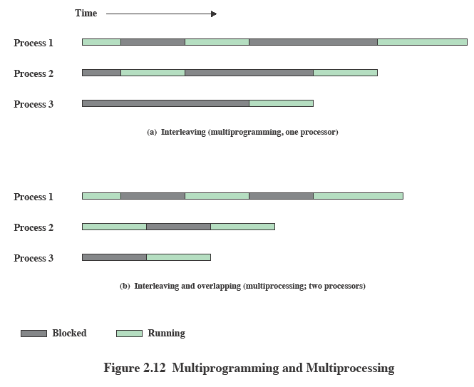
Multiprogramming Multiprocessing
Notes:
If the work to be done by a computer can be organized so that
some portions of the work can be done in parallel, then a system with multiple
processors will yield greater performance than one with a single processor of
the same type. This is illustrated in Figure 2.12 . With multiprogramming, only
one process can execute at a time; meanwhile all other processes are waiting
for the processor. With multiprocessing, more than one process can be running
simultaneously, each on a different processor.

Slide 35
Symmetric Multiprocessor OS Considerations
A multiprocessor OS must provide all the functionality of a multiprogramming system plus additional features to accommodate multiple processors
Key design issues:
Simultaneous concurrent processes or threads
kernel routines need to be reentrant to allow several processors to execute the same kernel code simultaneously
Scheduling
any processor may perform scheduling, which complicates the task of enforcing a scheduling policy
Synchronization
with multiple active processes having potential access to shared address spaces or shared I/O resources, care must be taken to provide effective synchronization
Memory management
the reuse of physical pages is the biggest problem of concern
Reliability and fault tolerance
the OS should provide graceful degradation in the face of processor failure
Notes:
In an SMP system, the kernel can execute on any processor, and typically each
processor does self-scheduling from the pool of available processes or threads.
The kernel can be constructed as multiple processes or multiple threads, allowing
portions of the kernel to execute in parallel. The SMP approach complicates the OS.
The OS designer must deal with the complexity due to sharing resources (like data
structures) and coordinating actions (like accessing devices) from multiple parts of
the OS executing at the same time. Techniques must be employed to resolve and
synchronize claims to resources.
An SMP operating system manages processor and other computer resources
so that the user may view the system in the same fashion as a multiprogramming
uniprocessor system. A user may construct applications that use multiple processes
or multiple threads within processes without regard to whether a single processor
or multiple processors will be available. Thus, a multiprocessor OS must provide all
the functionality of a multiprogramming system plus additional features to accommodate
multiple processors. The key design issues include the following:
• Simultaneous concurrent processes or threads: Kernel routines need to be
reentrant to allow several processors to execute the same kernel code simultaneously.
With multiple processors executing the same or different parts of the
kernel, kernel tables and management structures must be managed properly
to avoid data corruption or invalid operations.
• Scheduling: Any processor may perform scheduling, which complicates the
task of enforcing a scheduling policy and assuring that corruption of the scheduler
data structures is avoided. If kernel-level multithreading is used, then the
opportunity exists to schedule multiple threads from the same process simultaneously
on multiple processors. Multiprocessor scheduling is examined in
Chapter 10 .
• Synchronization: With multiple active processes having potential access to
shared address spaces or shared I/O resources, care must be taken to provide
effective synchronization. Synchronization is a facility that enforces mutual
exclusion and event ordering. A common synchronization mechanism used in
multiprocessor operating systems is locks, described in Chapter 5 .
• Memory management: Memory management on a multiprocessor must deal
with all of the issues found on uniprocessor computers and is discussed in Part
Three. In addition, the OS needs to exploit the available hardware parallelism
to achieve the best performance. The paging mechanisms on different processors
must be coordinated to enforce consistency when several processors
share a page or segment and to decide on page replacement. The reuse of
physical pages is the biggest problem of concern; that is, it must be guaranteed
that a physical page can no longer be accessed with its old contents before the
page is put to a new use.
Reliability and fault tolerance: The OS should provide graceful degradation
in the face of processor failure. The scheduler and other portions of the OS
must recognize the loss of a processor and restructure management tables
accordingly.
Because multiprocessor OS design issues generally involve extensions to
solutions to multiprogramming uniprocessor design problems, we do not treat
multiprocessor operating systems separately. Rather, specific multiprocessor issues
are addressed in the proper context throughout this book.

Slide 36
System Calls
Programmatic way in which a computer program requests a service from the kernel of the operating system it is executed on.
A system call is a way for programs to interact with the operating system.
System call provides the services of the operating system to the user programs via Application Program Interface(API).
It provides an interface between a process and operating system to allow user-level processes to request services of the operating system.
System calls are the only entry points into the kernel system. All programs needing resources must use system calls.
Notes:
The story of Windows begins with a very different OS, developed by Microsoft for
the first IBM personal computer and referred to as MS-DOS. The initial version,
MS-DOS 1.0, was released in August 1981. It consisted of 4000 lines of assembly
language source code and ran in 8 Kbytes of memory using the Intel 8086
microprocessor.
The IBM PC was an important stage in a continuing revolution in computing
that has expanded computing from the data center of the 1960s, to the departmental
minicomputer of the 1970s, and to the desktop in the 1980s. The revolution has continued
with computing moving into the briefcase in the 1990s, and into our pockets
during the most recent decade.
Microsoft’s initial OS ran a single application at a time, using a command line
interface to control the system. It took a long time for Microsoft to develop a true
GUI interface for the PC; on their third try they succeeded. The 16-bit Windows
3.0 shipped in 1990 and instantly became successful, selling a million copies in six
months. Windows 3.0 was implemented as a layer on top of MS-DOS and suffered
from the limitations of that primitive system. Five years later, Microsoft shipped a
32-bit version, Windows 95, which was also very successful and led to the development
of additional versions: Windows 98 and Windows Me.
Meanwhile, it had become clear to Microsoft that the MS-DOS platform could
not sustain a truly modern OS. In 1989 Microsoft hired Dave Cutler, who had developed
the very successful RSX-11M and VAX/VMS operating systems at Digital
Equipment Corporation. Cutler’s charter was to develop a modern OS, which was
portable to architectures other than the Intel x86 family, and yet compatible with
the OS/2 system that Microsoft was jointly developing with IBM, as well as the portable
UNIX standard, POSIX. This system was christened NT (New Technology).
The first version of Windows NT (3.1) was released in 1993, with the same GUI
as Windows 3.1, the follow-on to Windows 3.0. However, NT 3.1 was a new 32-bit
OS with the ability to support older DOS and Windows applications as well as provide
OS/2 support. Several versions of NT 3.x followed with support for additional
hardware platforms. In 1996, Microsoft released NT 4.0 with the same user interface
as Windows 95. In 2000, Microsoft introduced the next major upgrade of the NT OS:
Windows 2000. The underlying Executive and Kernel architecture is fundamentally
the same as in NT 3.1, but new features have been added. The emphasis in Windows
2000 was the addition of services and functions to support distributed processing.
The central element of Windows 2000’s new features was Active Directory, which
is a distributed directory service able to map names of arbitrary objects to any kind
of information about those objects. Windows 2000 also added the plug-and-play
and power-management facilities that were already in Windows 98, the successor to
Windows 95. These features are particularly important for laptop computers.
In 2001, a new desktop version of NT was released, known as Windows XP.
The goal of Windows XP was to finally replace the versions of Windows based on
MS-DOS with an OS based on NT. In 2007, Microsoft shipped Windows Vista for
the desktop and a short time later, Windows Server 2008. In 2009, they shipped
Windows 7 and Windows Server 2008 R2. Despite the difference in naming, the
client and server versions of these systems use many of the same files, but with additional
features and capabilities enabled for servers.
Over the years, NT has attempted to support multiple processor architectures;
the Intel i860 was the original target for NT as well as the x86. Subsequently, NT
added support for the Digital Alpha architecture, the PowerPC, and the MIPS.
Later came the Intel IA64 (Itanium) and the 64-bit version of the x86, based on
the AMD64 processor architecture. Windows 7 supports only x86 and AMD64.
Windows Server 2008 R2 supports only AMD64 and IA64—but Microsoft has
announced that it will end support for IA64 in future releases. All the other processor
architectures have failed in the market, and today only the x86, AMD64, and
ARM architectures are viable. Microsoft’s support for ARM is limited to their
Windows CE OS, which runs on phones and handheld devices. Windows CE has
little relationship to the NT-based Windows that runs on slates, netbooks/laptops,
desktops, and servers.
Microsoft has announced that it is developing a version of NT that targets
cloud computing: Windows Azure. Azure includes a number of features that are
specific to the requirements of public and private clouds. Though it is closely related
to Windows Server, it does not share files in the same way that the Windows client
and server versions do.

Slide 37
System Calls
Types of System Calls :
- System Calls for Process Management- end, abort, create, terminate, allocate and free memory.
- System Calls for File Management- create, open, close, delete, read file etc.
- System Calls for Directory Management- mount,
- Miscellaneous system calls- chdir, chmod etc.
Notes:
The story of Windows begins with a very different OS, developed by Microsoft for
the first IBM personal computer and referred to as MS-DOS. The initial version,
MS-DOS 1.0, was released in August 1981. It consisted of 4000 lines of assembly
language source code and ran in 8 Kbytes of memory using the Intel 8086
microprocessor.
The IBM PC was an important stage in a continuing revolution in computing
that has expanded computing from the data center of the 1960s, to the departmental
minicomputer of the 1970s, and to the desktop in the 1980s. The revolution has continued
with computing moving into the briefcase in the 1990s, and into our pockets
during the most recent decade.
Microsoft’s initial OS ran a single application at a time, using a command line
interface to control the system. It took a long time for Microsoft to develop a true
GUI interface for the PC; on their third try they succeeded. The 16-bit Windows
3.0 shipped in 1990 and instantly became successful, selling a million copies in six
months. Windows 3.0 was implemented as a layer on top of MS-DOS and suffered
from the limitations of that primitive system. Five years later, Microsoft shipped a
32-bit version, Windows 95, which was also very successful and led to the development
of additional versions: Windows 98 and Windows Me.
Meanwhile, it had become clear to Microsoft that the MS-DOS platform could
not sustain a truly modern OS. In 1989 Microsoft hired Dave Cutler, who had developed
the very successful RSX-11M and VAX/VMS operating systems at Digital
Equipment Corporation. Cutler’s charter was to develop a modern OS, which was
portable to architectures other than the Intel x86 family, and yet compatible with
the OS/2 system that Microsoft was jointly developing with IBM, as well as the portable
UNIX standard, POSIX. This system was christened NT (New Technology).
The first version of Windows NT (3.1) was released in 1993, with the same GUI
as Windows 3.1, the follow-on to Windows 3.0. However, NT 3.1 was a new 32-bit
OS with the ability to support older DOS and Windows applications as well as provide
OS/2 support. Several versions of NT 3.x followed with support for additional
hardware platforms. In 1996, Microsoft released NT 4.0 with the same user interface
as Windows 95. In 2000, Microsoft introduced the next major upgrade of the NT OS:
Windows 2000. The underlying Executive and Kernel architecture is fundamentally
the same as in NT 3.1, but new features have been added. The emphasis in Windows
2000 was the addition of services and functions to support distributed processing.
The central element of Windows 2000’s new features was Active Directory, which
is a distributed directory service able to map names of arbitrary objects to any kind
of information about those objects. Windows 2000 also added the plug-and-play
and power-management facilities that were already in Windows 98, the successor to
Windows 95. These features are particularly important for laptop computers.
In 2001, a new desktop version of NT was released, known as Windows XP.
The goal of Windows XP was to finally replace the versions of Windows based on
MS-DOS with an OS based on NT. In 2007, Microsoft shipped Windows Vista for
the desktop and a short time later, Windows Server 2008. In 2009, they shipped
Windows 7 and Windows Server 2008 R2. Despite the difference in naming, the
client and server versions of these systems use many of the same files, but with additional
features and capabilities enabled for servers.
Over the years, NT has attempted to support multiple processor architectures;
the Intel i860 was the original target for NT as well as the x86. Subsequently, NT
added support for the Digital Alpha architecture, the PowerPC, and the MIPS.
Later came the Intel IA64 (Itanium) and the 64-bit version of the x86, based on
the AMD64 processor architecture. Windows 7 supports only x86 and AMD64.
Windows Server 2008 R2 supports only AMD64 and IA64—but Microsoft has
announced that it will end support for IA64 in future releases. All the other processor
architectures have failed in the market, and today only the x86, AMD64, and
ARM architectures are viable. Microsoft’s support for ARM is limited to their
Windows CE OS, which runs on phones and handheld devices. Windows CE has
little relationship to the NT-based Windows that runs on slates, netbooks/laptops,
desktops, and servers.
Microsoft has announced that it is developing a version of NT that targets
cloud computing: Windows Azure. Azure includes a number of features that are
specific to the requirements of public and private clouds. Though it is closely related
to Windows Server, it does not share files in the same way that the Windows client
and server versions do.

Slide 38
Operating System Structures
Monolithic Systems
Entire operating system runs as a single program in kernel mode.
The operating system is written as a collection of procedures, linked together into a single large executable binary program.
When this technique is used, each procedure in the system is free to call any other one, if the latter provides some useful computation that the former needs.
Having thousands of procedures that can call each other without restriction often leads to an unwieldy and difficult to understand system.
Notes:
The story of Windows begins with a very different OS, developed by Microsoft for
the first IBM personal computer and referred to as MS-DOS. The initial version,
MS-DOS 1.0, was released in August 1981. It consisted of 4000 lines of assembly
language source code and ran in 8 Kbytes of memory using the Intel 8086
microprocessor.
The IBM PC was an important stage in a continuing revolution in computing
that has expanded computing from the data center of the 1960s, to the departmental
minicomputer of the 1970s, and to the desktop in the 1980s. The revolution has continued
with computing moving into the briefcase in the 1990s, and into our pockets
during the most recent decade.
Microsoft’s initial OS ran a single application at a time, using a command line
interface to control the system. It took a long time for Microsoft to develop a true
GUI interface for the PC; on their third try they succeeded. The 16-bit Windows
3.0 shipped in 1990 and instantly became successful, selling a million copies in six
months. Windows 3.0 was implemented as a layer on top of MS-DOS and suffered
from the limitations of that primitive system. Five years later, Microsoft shipped a
32-bit version, Windows 95, which was also very successful and led to the development
of additional versions: Windows 98 and Windows Me.
Meanwhile, it had become clear to Microsoft that the MS-DOS platform could
not sustain a truly modern OS. In 1989 Microsoft hired Dave Cutler, who had developed
the very successful RSX-11M and VAX/VMS operating systems at Digital
Equipment Corporation. Cutler’s charter was to develop a modern OS, which was
portable to architectures other than the Intel x86 family, and yet compatible with
the OS/2 system that Microsoft was jointly developing with IBM, as well as the portable
UNIX standard, POSIX. This system was christened NT (New Technology).
The first version of Windows NT (3.1) was released in 1993, with the same GUI
as Windows 3.1, the follow-on to Windows 3.0. However, NT 3.1 was a new 32-bit
OS with the ability to support older DOS and Windows applications as well as provide
OS/2 support. Several versions of NT 3.x followed with support for additional
hardware platforms. In 1996, Microsoft released NT 4.0 with the same user interface
as Windows 95. In 2000, Microsoft introduced the next major upgrade of the NT OS:
Windows 2000. The underlying Executive and Kernel architecture is fundamentally
the same as in NT 3.1, but new features have been added. The emphasis in Windows
2000 was the addition of services and functions to support distributed processing.
The central element of Windows 2000’s new features was Active Directory, which
is a distributed directory service able to map names of arbitrary objects to any kind
of information about those objects. Windows 2000 also added the plug-and-play
and power-management facilities that were already in Windows 98, the successor to
Windows 95. These features are particularly important for laptop computers.
In 2001, a new desktop version of NT was released, known as Windows XP.
The goal of Windows XP was to finally replace the versions of Windows based on
MS-DOS with an OS based on NT. In 2007, Microsoft shipped Windows Vista for
the desktop and a short time later, Windows Server 2008. In 2009, they shipped
Windows 7 and Windows Server 2008 R2. Despite the difference in naming, the
client and server versions of these systems use many of the same files, but with additional
features and capabilities enabled for servers.
Over the years, NT has attempted to support multiple processor architectures;
the Intel i860 was the original target for NT as well as the x86. Subsequently, NT
added support for the Digital Alpha architecture, the PowerPC, and the MIPS.
Later came the Intel IA64 (Itanium) and the 64-bit version of the x86, based on
the AMD64 processor architecture. Windows 7 supports only x86 and AMD64.
Windows Server 2008 R2 supports only AMD64 and IA64—but Microsoft has
announced that it will end support for IA64 in future releases. All the other processor
architectures have failed in the market, and today only the x86, AMD64, and
ARM architectures are viable. Microsoft’s support for ARM is limited to their
Windows CE OS, which runs on phones and handheld devices. Windows CE has
little relationship to the NT-based Windows that runs on slates, netbooks/laptops,
desktops, and servers.
Microsoft has announced that it is developing a version of NT that targets
cloud computing: Windows Azure. Azure includes a number of features that are
specific to the requirements of public and private clouds. Though it is closely related
to Windows Server, it does not share files in the same way that the Windows client
and server versions do.

Slide 39
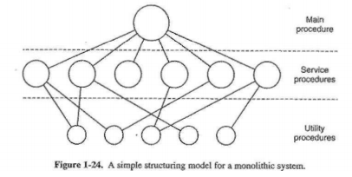
Operating System Structures
Monolithic Systems
No provision of information hiding
This organization suggests a basic structure for the operating system:
1. A main program that invokes the requested service procedure.
2. A set of service procedures that carry out the system calls.
3. A set of utility procedures that help the service procedures
Notes:
The story of Windows begins with a very different OS, developed by Microsoft for
the first IBM personal computer and referred to as MS-DOS. The initial version,
MS-DOS 1.0, was released in August 1981. It consisted of 4000 lines of assembly
language source code and ran in 8 Kbytes of memory using the Intel 8086
microprocessor.
The IBM PC was an important stage in a continuing revolution in computing
that has expanded computing from the data center of the 1960s, to the departmental
minicomputer of the 1970s, and to the desktop in the 1980s. The revolution has continued
with computing moving into the briefcase in the 1990s, and into our pockets
during the most recent decade.
Microsoft’s initial OS ran a single application at a time, using a command line
interface to control the system. It took a long time for Microsoft to develop a true
GUI interface for the PC; on their third try they succeeded. The 16-bit Windows
3.0 shipped in 1990 and instantly became successful, selling a million copies in six
months. Windows 3.0 was implemented as a layer on top of MS-DOS and suffered
from the limitations of that primitive system. Five years later, Microsoft shipped a
32-bit version, Windows 95, which was also very successful and led to the development
of additional versions: Windows 98 and Windows Me.
Meanwhile, it had become clear to Microsoft that the MS-DOS platform could
not sustain a truly modern OS. In 1989 Microsoft hired Dave Cutler, who had developed
the very successful RSX-11M and VAX/VMS operating systems at Digital
Equipment Corporation. Cutler’s charter was to develop a modern OS, which was
portable to architectures other than the Intel x86 family, and yet compatible with
the OS/2 system that Microsoft was jointly developing with IBM, as well as the portable
UNIX standard, POSIX. This system was christened NT (New Technology).
The first version of Windows NT (3.1) was released in 1993, with the same GUI
as Windows 3.1, the follow-on to Windows 3.0. However, NT 3.1 was a new 32-bit
OS with the ability to support older DOS and Windows applications as well as provide
OS/2 support. Several versions of NT 3.x followed with support for additional
hardware platforms. In 1996, Microsoft released NT 4.0 with the same user interface
as Windows 95. In 2000, Microsoft introduced the next major upgrade of the NT OS:
Windows 2000. The underlying Executive and Kernel architecture is fundamentally
the same as in NT 3.1, but new features have been added. The emphasis in Windows
2000 was the addition of services and functions to support distributed processing.
The central element of Windows 2000’s new features was Active Directory, which
is a distributed directory service able to map names of arbitrary objects to any kind
of information about those objects. Windows 2000 also added the plug-and-play
and power-management facilities that were already in Windows 98, the successor to
Windows 95. These features are particularly important for laptop computers.
In 2001, a new desktop version of NT was released, known as Windows XP.
The goal of Windows XP was to finally replace the versions of Windows based on
MS-DOS with an OS based on NT. In 2007, Microsoft shipped Windows Vista for
the desktop and a short time later, Windows Server 2008. In 2009, they shipped
Windows 7 and Windows Server 2008 R2. Despite the difference in naming, the
client and server versions of these systems use many of the same files, but with additional
features and capabilities enabled for servers.
Over the years, NT has attempted to support multiple processor architectures;
the Intel i860 was the original target for NT as well as the x86. Subsequently, NT
added support for the Digital Alpha architecture, the PowerPC, and the MIPS.
Later came the Intel IA64 (Itanium) and the 64-bit version of the x86, based on
the AMD64 processor architecture. Windows 7 supports only x86 and AMD64.
Windows Server 2008 R2 supports only AMD64 and IA64—but Microsoft has
announced that it will end support for IA64 in future releases. All the other processor
architectures have failed in the market, and today only the x86, AMD64, and
ARM architectures are viable. Microsoft’s support for ARM is limited to their
Windows CE OS, which runs on phones and handheld devices. Windows CE has
little relationship to the NT-based Windows that runs on slates, netbooks/laptops,
desktops, and servers.
Microsoft has announced that it is developing a version of NT that targets
cloud computing: Windows Azure. Azure includes a number of features that are
specific to the requirements of public and private clouds. Though it is closely related
to Windows Server, it does not share files in the same way that the Windows client
and server versions do.

Slide 40
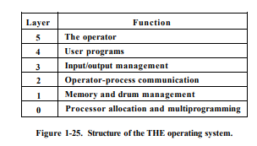
Operating System Structures
Layered Systems
Operating system is organised as a hierarchy of layers, each one constructed upon the one below it.
The main advantage is simplicity of construction and debugging.
The main difficulty is defining the various layers. The main disadvantage is that the OS tends to be less efficient than other implementations
Notes:
The story of Windows begins with a very different OS, developed by Microsoft for
the first IBM personal computer and referred to as MS-DOS. The initial version,
MS-DOS 1.0, was released in August 1981. It consisted of 4000 lines of assembly
language source code and ran in 8 Kbytes of memory using the Intel 8086
microprocessor.
The IBM PC was an important stage in a continuing revolution in computing
that has expanded computing from the data center of the 1960s, to the departmental
minicomputer of the 1970s, and to the desktop in the 1980s. The revolution has continued
with computing moving into the briefcase in the 1990s, and into our pockets
during the most recent decade.
Microsoft’s initial OS ran a single application at a time, using a command line
interface to control the system. It took a long time for Microsoft to develop a true
GUI interface for the PC; on their third try they succeeded. The 16-bit Windows
3.0 shipped in 1990 and instantly became successful, selling a million copies in six
months. Windows 3.0 was implemented as a layer on top of MS-DOS and suffered
from the limitations of that primitive system. Five years later, Microsoft shipped a
32-bit version, Windows 95, which was also very successful and led to the development
of additional versions: Windows 98 and Windows Me.
Meanwhile, it had become clear to Microsoft that the MS-DOS platform could
not sustain a truly modern OS. In 1989 Microsoft hired Dave Cutler, who had developed
the very successful RSX-11M and VAX/VMS operating systems at Digital
Equipment Corporation. Cutler’s charter was to develop a modern OS, which was
portable to architectures other than the Intel x86 family, and yet compatible with
the OS/2 system that Microsoft was jointly developing with IBM, as well as the portable
UNIX standard, POSIX. This system was christened NT (New Technology).
The first version of Windows NT (3.1) was released in 1993, with the same GUI
as Windows 3.1, the follow-on to Windows 3.0. However, NT 3.1 was a new 32-bit
OS with the ability to support older DOS and Windows applications as well as provide
OS/2 support. Several versions of NT 3.x followed with support for additional
hardware platforms. In 1996, Microsoft released NT 4.0 with the same user interface
as Windows 95. In 2000, Microsoft introduced the next major upgrade of the NT OS:
Windows 2000. The underlying Executive and Kernel architecture is fundamentally
the same as in NT 3.1, but new features have been added. The emphasis in Windows
2000 was the addition of services and functions to support distributed processing.
The central element of Windows 2000’s new features was Active Directory, which
is a distributed directory service able to map names of arbitrary objects to any kind
of information about those objects. Windows 2000 also added the plug-and-play
and power-management facilities that were already in Windows 98, the successor to
Windows 95. These features are particularly important for laptop computers.
In 2001, a new desktop version of NT was released, known as Windows XP.
The goal of Windows XP was to finally replace the versions of Windows based on
MS-DOS with an OS based on NT. In 2007, Microsoft shipped Windows Vista for
the desktop and a short time later, Windows Server 2008. In 2009, they shipped
Windows 7 and Windows Server 2008 R2. Despite the difference in naming, the
client and server versions of these systems use many of the same files, but with additional
features and capabilities enabled for servers.
Over the years, NT has attempted to support multiple processor architectures;
the Intel i860 was the original target for NT as well as the x86. Subsequently, NT
added support for the Digital Alpha architecture, the PowerPC, and the MIPS.
Later came the Intel IA64 (Itanium) and the 64-bit version of the x86, based on
the AMD64 processor architecture. Windows 7 supports only x86 and AMD64.
Windows Server 2008 R2 supports only AMD64 and IA64—but Microsoft has
announced that it will end support for IA64 in future releases. All the other processor
architectures have failed in the market, and today only the x86, AMD64, and
ARM architectures are viable. Microsoft’s support for ARM is limited to their
Windows CE OS, which runs on phones and handheld devices. Windows CE has
little relationship to the NT-based Windows that runs on slates, netbooks/laptops,
desktops, and servers.
Microsoft has announced that it is developing a version of NT that targets
cloud computing: Windows Azure. Azure includes a number of features that are
specific to the requirements of public and private clouds. Though it is closely related
to Windows Server, it does not share files in the same way that the Windows client
and server versions do.

Slide 41
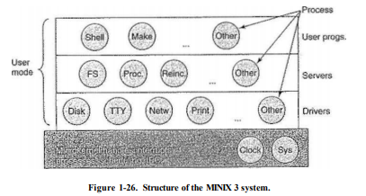
Operating System Structures
Microkernel
The basic idea behind the microkernel design is to achieve high reliability by splitting the operating system up into small, well-defined modules
Only microkernel runs in kernel mode and the rest run as relatively powerless ordinary user processes.
Notes:
The story of Windows begins with a very different OS, developed by Microsoft for
the first IBM personal computer and referred to as MS-DOS. The initial version,
MS-DOS 1.0, was released in August 1981. It consisted of 4000 lines of assembly
language source code and ran in 8 Kbytes of memory using the Intel 8086
microprocessor.
The IBM PC was an important stage in a continuing revolution in computing
that has expanded computing from the data center of the 1960s, to the departmental
minicomputer of the 1970s, and to the desktop in the 1980s. The revolution has continued
with computing moving into the briefcase in the 1990s, and into our pockets
during the most recent decade.
Microsoft’s initial OS ran a single application at a time, using a command line
interface to control the system. It took a long time for Microsoft to develop a true
GUI interface for the PC; on their third try they succeeded. The 16-bit Windows
3.0 shipped in 1990 and instantly became successful, selling a million copies in six
months. Windows 3.0 was implemented as a layer on top of MS-DOS and suffered
from the limitations of that primitive system. Five years later, Microsoft shipped a
32-bit version, Windows 95, which was also very successful and led to the development
of additional versions: Windows 98 and Windows Me.
Meanwhile, it had become clear to Microsoft that the MS-DOS platform could
not sustain a truly modern OS. In 1989 Microsoft hired Dave Cutler, who had developed
the very successful RSX-11M and VAX/VMS operating systems at Digital
Equipment Corporation. Cutler’s charter was to develop a modern OS, which was
portable to architectures other than the Intel x86 family, and yet compatible with
the OS/2 system that Microsoft was jointly developing with IBM, as well as the portable
UNIX standard, POSIX. This system was christened NT (New Technology).
The first version of Windows NT (3.1) was released in 1993, with the same GUI
as Windows 3.1, the follow-on to Windows 3.0. However, NT 3.1 was a new 32-bit
OS with the ability to support older DOS and Windows applications as well as provide
OS/2 support. Several versions of NT 3.x followed with support for additional
hardware platforms. In 1996, Microsoft released NT 4.0 with the same user interface
as Windows 95. In 2000, Microsoft introduced the next major upgrade of the NT OS:
Windows 2000. The underlying Executive and Kernel architecture is fundamentally
the same as in NT 3.1, but new features have been added. The emphasis in Windows
2000 was the addition of services and functions to support distributed processing.
The central element of Windows 2000’s new features was Active Directory, which
is a distributed directory service able to map names of arbitrary objects to any kind
of information about those objects. Windows 2000 also added the plug-and-play
and power-management facilities that were already in Windows 98, the successor to
Windows 95. These features are particularly important for laptop computers.
In 2001, a new desktop version of NT was released, known as Windows XP.
The goal of Windows XP was to finally replace the versions of Windows based on
MS-DOS with an OS based on NT. In 2007, Microsoft shipped Windows Vista for
the desktop and a short time later, Windows Server 2008. In 2009, they shipped
Windows 7 and Windows Server 2008 R2. Despite the difference in naming, the
client and server versions of these systems use many of the same files, but with additional
features and capabilities enabled for servers.
Over the years, NT has attempted to support multiple processor architectures;
the Intel i860 was the original target for NT as well as the x86. Subsequently, NT
added support for the Digital Alpha architecture, the PowerPC, and the MIPS.
Later came the Intel IA64 (Itanium) and the 64-bit version of the x86, based on
the AMD64 processor architecture. Windows 7 supports only x86 and AMD64.
Windows Server 2008 R2 supports only AMD64 and IA64—but Microsoft has
announced that it will end support for IA64 in future releases. All the other processor
architectures have failed in the market, and today only the x86, AMD64, and
ARM architectures are viable. Microsoft’s support for ARM is limited to their
Windows CE OS, which runs on phones and handheld devices. Windows CE has
little relationship to the NT-based Windows that runs on slates, netbooks/laptops,
desktops, and servers.
Microsoft has announced that it is developing a version of NT that targets
cloud computing: Windows Azure. Azure includes a number of features that are
specific to the requirements of public and private clouds. Though it is closely related
to Windows Server, it does not share files in the same way that the Windows client
and server versions do.

Slide 42
Operating System Structures
Client Server Model
Distinguishes two classes of processes, the servers, each of which provides some service, and the clients, which use these services.
Often the lowest layer is a microkernel
Communication between clients and servers is often by message passing.
Notes:
The story of Windows begins with a very different OS, developed by Microsoft for
the first IBM personal computer and referred to as MS-DOS. The initial version,
MS-DOS 1.0, was released in August 1981. It consisted of 4000 lines of assembly
language source code and ran in 8 Kbytes of memory using the Intel 8086
microprocessor.
The IBM PC was an important stage in a continuing revolution in computing
that has expanded computing from the data center of the 1960s, to the departmental
minicomputer of the 1970s, and to the desktop in the 1980s. The revolution has continued
with computing moving into the briefcase in the 1990s, and into our pockets
during the most recent decade.
Microsoft’s initial OS ran a single application at a time, using a command line
interface to control the system. It took a long time for Microsoft to develop a true
GUI interface for the PC; on their third try they succeeded. The 16-bit Windows
3.0 shipped in 1990 and instantly became successful, selling a million copies in six
months. Windows 3.0 was implemented as a layer on top of MS-DOS and suffered
from the limitations of that primitive system. Five years later, Microsoft shipped a
32-bit version, Windows 95, which was also very successful and led to the development
of additional versions: Windows 98 and Windows Me.
Meanwhile, it had become clear to Microsoft that the MS-DOS platform could
not sustain a truly modern OS. In 1989 Microsoft hired Dave Cutler, who had developed
the very successful RSX-11M and VAX/VMS operating systems at Digital
Equipment Corporation. Cutler’s charter was to develop a modern OS, which was
portable to architectures other than the Intel x86 family, and yet compatible with
the OS/2 system that Microsoft was jointly developing with IBM, as well as the portable
UNIX standard, POSIX. This system was christened NT (New Technology).
The first version of Windows NT (3.1) was released in 1993, with the same GUI
as Windows 3.1, the follow-on to Windows 3.0. However, NT 3.1 was a new 32-bit
OS with the ability to support older DOS and Windows applications as well as provide
OS/2 support. Several versions of NT 3.x followed with support for additional
hardware platforms. In 1996, Microsoft released NT 4.0 with the same user interface
as Windows 95. In 2000, Microsoft introduced the next major upgrade of the NT OS:
Windows 2000. The underlying Executive and Kernel architecture is fundamentally
the same as in NT 3.1, but new features have been added. The emphasis in Windows
2000 was the addition of services and functions to support distributed processing.
The central element of Windows 2000’s new features was Active Directory, which
is a distributed directory service able to map names of arbitrary objects to any kind
of information about those objects. Windows 2000 also added the plug-and-play
and power-management facilities that were already in Windows 98, the successor to
Windows 95. These features are particularly important for laptop computers.
In 2001, a new desktop version of NT was released, known as Windows XP.
The goal of Windows XP was to finally replace the versions of Windows based on
MS-DOS with an OS based on NT. In 2007, Microsoft shipped Windows Vista for
the desktop and a short time later, Windows Server 2008. In 2009, they shipped
Windows 7 and Windows Server 2008 R2. Despite the difference in naming, the
client and server versions of these systems use many of the same files, but with additional
features and capabilities enabled for servers.
Over the years, NT has attempted to support multiple processor architectures;
the Intel i860 was the original target for NT as well as the x86. Subsequently, NT
added support for the Digital Alpha architecture, the PowerPC, and the MIPS.
Later came the Intel IA64 (Itanium) and the 64-bit version of the x86, based on
the AMD64 processor architecture. Windows 7 supports only x86 and AMD64.
Windows Server 2008 R2 supports only AMD64 and IA64—but Microsoft has
announced that it will end support for IA64 in future releases. All the other processor
architectures have failed in the market, and today only the x86, AMD64, and
ARM architectures are viable. Microsoft’s support for ARM is limited to their
Windows CE OS, which runs on phones and handheld devices. Windows CE has
little relationship to the NT-based Windows that runs on slates, netbooks/laptops,
desktops, and servers.
Microsoft has announced that it is developing a version of NT that targets
cloud computing: Windows Azure. Azure includes a number of features that are
specific to the requirements of public and private clouds. Though it is closely related
to Windows Server, it does not share files in the same way that the Windows client
and server versions do.

